Slide 1
Data Structures and Algorithms -3 (25CS2103E)
Question Bank Management System
Team Members
S. Prem Sai (2520030561)
D. Mohit Venkat Sai (2520030106)
Under the Esteemed Guidance of
Dr. V. Sireesha, Professor, Department of CSE

Slide 2
Contents
Abstract
Introduction
Literature Survey
Problem Statement and Objectives
Flow Chart
Implementation Progress (Results)
Testing Results
Limitations and Fix Plan
Hardware and Software Requirements
Conclusion
Future Scope

Slide 3
Abstract
Faculty who set examination papers must find suitable questions quickly, avoid repeating earlier questions, and still find the right question when a keyword is misspelt. The Question Bank Management System (QBMS) stores, searches and checks examination questions using classical string-matching algorithms. It has two clients that share the same algorithms: a Java console application and a browser-based web application. Exact keyword search uses Knuth-Morris-Pratt, Rabin-Karp and Boyer-Moore-Horspool; several keywords are searched in one pass with an Aho-Corasick automaton; and typo-tolerant search, pairwise similarity and duplicate detection use Levenshtein edit distance computed by dynamic programming. This review presents the implemented modules, test results on a corpus of 51 questions in four subjects, and the limitations to be fixed before the final review.

Slide 4
Introduction
Faculty at educational institutions manage examination question repositories that grow into thousands of entries across subjects, units, and difficulty levels, making manual search slow and error-prone. Repeated questions build up unnoticed when question sets from different years are merged, and a single misspelt keyword makes a plain search fail. The Question Bank Management System applies classical string-matching algorithms to this problem: exact pattern matching for keyword lookup, a multi-pattern automaton to search several keywords at once, and edit-distance dynamic programming for typo-tolerant search and near-duplicate detection, so faculty can search, filter, and assemble question papers more quickly.

Slide 5
Literature Survey
Existing question-bank tools rely mostly on exact-match SQL queries (LIKE clauses), which fail on typos, synonyms, or minor keyword variations.
Knuth-Morris-Pratt (KMP), Boyer-Moore and Rabin-Karp (rolling hash) are established algorithms for exact substring matching; Aho-Corasick extends this to many patterns in a single pass over the text.
Levenshtein (edit) distance is a widely used metric for fuzzy/approximate string matching and spell-tolerant search.
Cosine similarity and Jaccard similarity are standard techniques in information retrieval for measuring textual similarity and detecting near-duplicate content.
Hash Maps and balanced Trees are commonly used in existing systems to index records for O(1)/O(log n) retrieval by category, topic, or difficulty.

Slide 6
Problem Statement and Objectives
Problem Statement: Manually searching, filtering, and de-duplicating large question banks is time-consuming and error-prone for faculty preparing exams.
Store questions with subject, unit, difficulty and year, and support add, update, delete and multi-criteria filtering.
Implement exact keyword search with KMP, Rabin-Karp and Boyer-Moore-Horspool, and multi-keyword search with Aho-Corasick.
Implement typo-tolerant fuzzy search using Levenshtein edit distance (dynamic programming).
Detect near-duplicate questions by scoring the similarity of every pair of questions.
Index questions with Hash Maps and sorted Trees for faster look-up by ID, subject and year (planned for the final review).

Slide 7
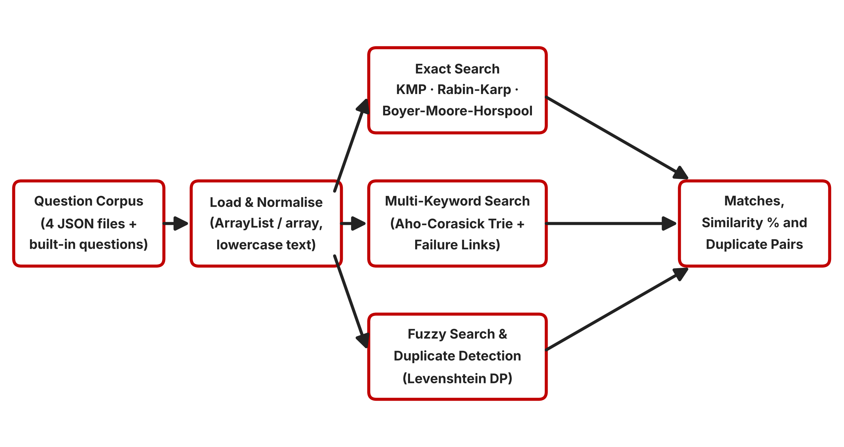
Flow Chart

Slide 8
Results
Java console client: 11-option menu with add, view, edit and delete; KMP, Rabin-Karp, Aho-Corasick and fuzzy search; question similarity and duplicate detection.
Web client (HTML, CSS, JavaScript): the same algorithms plus Boyer-Moore-Horspool, step-by-step visualisers (LPS array, rolling hashes, trie, DP matrix), JSON import/export, filters and a unit-wise paper generator.
Data corpus: 51 questions in four JSON files (DSA, OS, DBMS, CN); 74 questions after merging with the built-in sets in the web client.
Similarity: Levenshtein edit-distance percentage. Word-level (Jaccard / cosine) similarity is not yet implemented.
Repository: KLH_CSE_2026-27_S8_Team-23_QBMS on GitHub, with commits made by each team member.

Slide 9
Testing Results
0
mismatches in 300,000+ randomised tests against a brute-force reference (KMP, Rabin-Karp, Boyer-Moore-Horspool, Aho-Corasick)
4.4×
faster: one Aho-Corasick pass vs. three KMP passes for 3 keywords on a 102,000-question scaled corpus
6 of 7
pairs flagged at a 60% similarity threshold were genuine repeats across question sets
35% vs 76%
a reworded copy of the same question scores 35.1%, while two different topics sharing a sentence template score 75.7%

Slide 10
Limitations and Fix Plan
Current limitation | Fix before the final review
Console client uses only its 14 built-in questions; the JSON corpus loads only in the web client | Load the four JSON files in the Java client
Console fuzzy search misses typos ("binary serch" returns no results) | Port the web client's sliding-window fuzzy search to Java
Character-level similarity misses reworded duplicates and flags shared sentence templates | Add word-level Jaccard / cosine similarity with stop-word removal
Questions kept in a list, so look-up by ID or subject needs a full scan | HashMap indexes by ID and subject; TreeMap ordered by year
Java KMP and Rabin-Karp report only found / not found | Return every match position, as the JavaScript versions do
Paper generator lists all questions by unit; no target marks or difficulty split | Select questions to meet target marks per unit and difficulty
Repository is a flat folder; README lacks team, guide, abstract and phase status | Reorganise into /src, /docs, /data, /results, /reports and complete the README

Slide 11
Hardware and Software requirements
Hardware: Minimum 8 GB RAM, dual-core processor or higher, 500 MB free disk space.
Software: Java JDK 8 or later for the console client; any modern browser (Chrome, Edge, Firefox) for the web client.
Languages: Java, HTML5, CSS3 and JavaScript, with no external libraries or build tools.
IDE and Version Control: VS Code; Git and GitHub for repository management and collaboration.
Operating System: Windows / Linux / macOS.

Slide 12
Conclusion
At Review-2, the core string-matching modules are implemented in both the Java console client and the web client: KMP, Rabin-Karp and Boyer-Moore-Horspool for exact search, Aho-Corasick for multi-keyword search, and Levenshtein edit distance for fuzzy search and duplicate detection. Randomised testing against a brute-force reference found no mismatches, and Aho-Corasick searched three keywords about 4.4 times faster than repeated KMP. Testing also exposed clear limitations: the console client does not yet load the JSON corpus or tolerate typos, and character-level similarity misses reworded duplicates. These are the focus of the work before the final review.

Slide 13
Future Scope
Word-level similarity (Jaccard / cosine over TF-IDF vectors) alongside Levenshtein, to catch reworded duplicates.
Hash Map and TreeMap indexes for O(1) / O(log n) look-up by ID, subject, difficulty and year.
Balanced paper generation that picks questions to meet target marks per unit and a difficulty split.
A BK-tree over the vocabulary for fast typo suggestions, and a larger prime modulus for Rabin-Karp.
Server-side storage and authentication (for example Spring Boot with MySQL) so faculty can share one bank securely.

Slide 14
Thank you

